Slide 1

Resampling MEthods
Chapter 05

Slide 2
Outline
Cross Validation
The Validation Set Approach
Leave-One-Out Cross Validation
K-fold Cross Validation
Bias-Variance Trade-off for k-fold Cross Validation
Cross Validation on Classification Problems
Boostrap and Bagging

Slide 3
What are resampling methods?
Tools that involves repeatedly drawing samples from a training set and refitting a model of interest on each sample in order to obtain more information about the fitted model
Model Assessment: estimate test error rates
Model Selection: select the appropriate level of model flexibility
They are computationally expensive! But these days we have powerful computers ☺
Two resampling methods:
Cross Validation
Bootstrapping
Notes:
Resampling methods are an indispensable tool in modern statistics. They involve repeatedly drawing samples from a training set and refitting a model of interest on each sample in order to obtain additional information about the fitted model. For example, in order to estimate the variability of a linear regression fit, we can repeatedly draw different samples from the training data, fit a linear regression to each new sample, and then examine the extent to which the resulting fits differ. Such an approach may allow us to obtain information that would not be available from fitting the model only once using the original training sample.
Resampling approaches can be computationally expensive, because they involve fitting the same statistical method multiple times using different subsets of the training data. However, due to recent advances in computing power, the computational requirements of resampling methods generally are not prohibitive.
In this chapter, we discuss two of the most commonly used resampling methods, cross-validation and the bootstrap.
Both methods are important tools in the practical application of many statistical learning procedures.

Slide 4
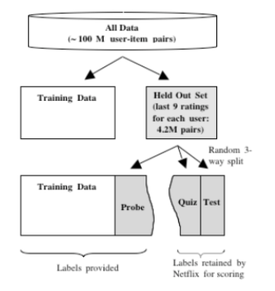
Recall Study design
Notes:
In Chapter 2 we discuss the distinction between the test error rate and the training error rate. The test error is the average error that results from using a statistical learning method to predict the response on a new observation— that is, a measurement that was not used in training the method. Given a data set, the use of a particular statistical learning method is warranted if it results in a low test error. The test error can be easily calculated if a designated test set is available. Unfortunately, this is usually not the case. In contrast, the training error can be easily calculated by applying the statistical learning method to the observations used in its training. But as we saw in Chapter 2, the training error rate often is quite different from the test error rate, and in particular the former can dramatically underestimate the latter.

Slide 5
Key idea
Accuracy on the training set (resubstitution accuracy) is optimistic
A better estimate comes from an independent set (test set accuracy)
But we can’t use the test set when building the model or it becomes part of the training set
So we estimate the test set accuracy with the training set
Notes:
In the absence of a very large designated test set that can be used to directly estimate the test error rate, a number of techniques can be used to estimate this quantity using the available training data. Some methods make a mathematical adjustment to the training error rate in order to estimate the test error rate. Such approaches are discussed in Chapter 6. In this section, we instead consider a class of methods that estimate the test error rate by holding out a subset of the training observations from the fitting process, and then applying the statistical learning method to those held out observations.
In Sections 5.1.1–5.1.4, for simplicity we assume that we are interested in performing regression with a quantitative response. In Section 5.1.5 we consider the case of classification with a qualitative response. As we will see, the key concepts remain the same regardless of whether the response is quantitative or qualitative
STOP

Slide 6
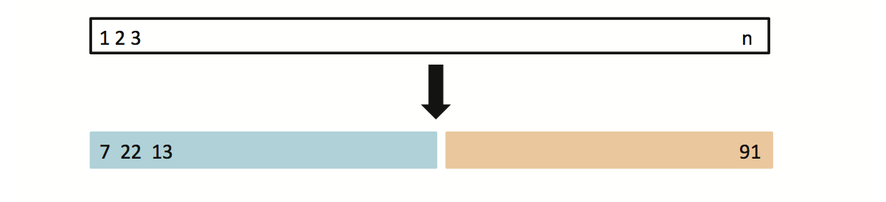
5.1.1 Typical Approach: The Validation Set Approach
Suppose that we would like to find a set of variables that give the lowest test (not training) error rate
If we have a large data set, we can achieve this goal by randomly splitting the data into training and validation(testing) parts
We would then use the training part to build each possible model (i.e. the different combinations of variables) and choose the model that gave the lowest error rate when applied to the validation data
Training Data
Testing Data
Notes:
Suppose that we would like to estimate the test error associated with fitting a particular statistical learning method on a set of observations. The validation set approach, displayed in Figure 5.1, is a very simple strategy validation for this task. It involves randomly dividing the available set of observations into two parts, a training set and a validation set or hold-out set. The model is fit on the training set, and the fitted model is used to predict the responses for the observations in the validation set. The resulting validation set error rate—typically assessed using MSE in the case of a quantitative response—provides an estimate of the test error rate.

Slide 7
Example: Auto Data
Suppose that we want to predict mpg from horsepower
Two models:
mpg ~ horsepower
mpg ~ horsepower + horspower²
Which model gives a better fit?
Randomly split Auto data set into training (196 obs.) and validation data (196 obs.)
Fit both models using the training data set
Then, evaluate both models using the validation data set
The model with the lowest validation (testing) MSE is the winner!
Notes:
We illustrate the validation set approach on the Auto data set. Recall from Chapter 3 that there appears to be a non-linear relationship between mpg and horsepower, and that a model that predicts mpg using horsepower and horsepower2 gives better results than a model that uses only a linear term. It is natural to wonder whether a cubic or higher-order fit might provide even better results. We answered this question in Chapter 3 by looking at the p-values associated with a cubic term and higher-order polynomial terms in a linear regression. But we could also answer this question using the validation method. What happens is, we’ll randomly split the 392 observations into two sets, a training set containing 196 of the data points, and a validation set containing the remaining 196 observations. The validation set error rates that result from fitting these various regression models on the training sample with multiple higher order polynomials of horsepower are evaluated using their performance on the validation sample, with MSE as a measure of validation set error, and whichever provides the lowest error wine.

Slide 8
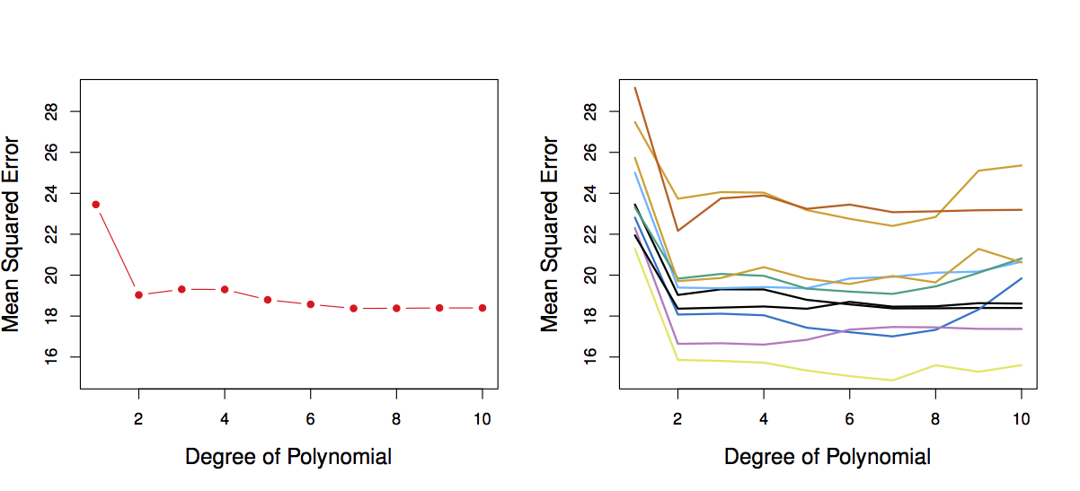
Results: Auto Data
Left: Validation error rate for a single split
Right: Validation method repeated 10 times, each time the split is done randomly!
There is a lot of variability among the MSE’s… Not good! We need more stable methods!
Notes:
The results are shown in the left-hand panel of Figure. The validation set MSE for the quadratic fit is considerably smaller than for the linear fit. However, the validation set MSE for the cubic fit is actually slightly larger than for the quadratic fit. This implies that including a cubic term in the regression does not lead to better prediction than simply using a quadratic term.
Recall that in order to create the left-hand panel of Figure, we randomly divided the data set into two parts, a training set and a validation set. If we repeat the process of randomly splitting the sample set into two parts, we will get a somewhat different estimate for the test MSE. As an illustration, the right-hand panel of Figure displays ten different validation set MSE curves from the Auto data set, produced using ten different random splits of the observations into training and validation sets. All ten curves indicate that the model with a quadratic term has a dramatically smaller validation set MSE than the model with only a linear term. Furthermore, all ten curves indicate that there is not much benefit in including cubic or higher-order polynomial terms in the model. But it is worth noting that each of the ten curves results in a different test MSE estimate for each of the ten regression models considered. And there is no consensus among the curves as to which model results in the smallest validation set MSE. Based on the variability among these curves, all that we can conclude with any confidence is that the linear fit is not adequate for this data.

Slide 9
The Validation Set Approach
Advantages:
Simple
Easy to implement
Disadvantages:
The validation MSE can be highly variable
Only a subset of observations are used to fit the model (training data). Statistical methods tend to perform worse when trained on fewer observations
Notes:
The validation set approach is conceptually simple and is easy to implement. But it has two potential drawbacks:
As is shown in the right-hand panel of Figure 5.2, the validation estimate of the test error rate can be highly variable, depending on precisely which observations are included in the training set and which observations are included in the validation set.
In the validation approach, only a subset of the observations—those that are included in the training set rather than in the validation set—are used to fit the model. Since statistical methods tend to perform worse when trained on fewer observations, this suggests that the validation set error rate may tend to overestimate the test error rate for the model fit on the entire data set.

Slide 10
Cross-validation
Approach:
Use the training set
Split it into training/test sets
Build a model on the training set
Evaluate on the test set
Repeat and average the estimated errors
Used for:
Picking variable to include in a model
Picking the type of prediction function to use
Picking the parameters in the prediction function
Comparing different predictors
Notes:
cross-validation is a refinement of the validation set approach that addresses these two issues.
cross-validation can be used to estimate the test error associated with a given statistical learning method in order to evaluate its performance, or to select the appropriate level of flexibility. The process of evaluating a model’s performance is known as model assessment, whereas the process of selecting the proper level of flexibility for a model is known as model selection.
STOP

Slide 11
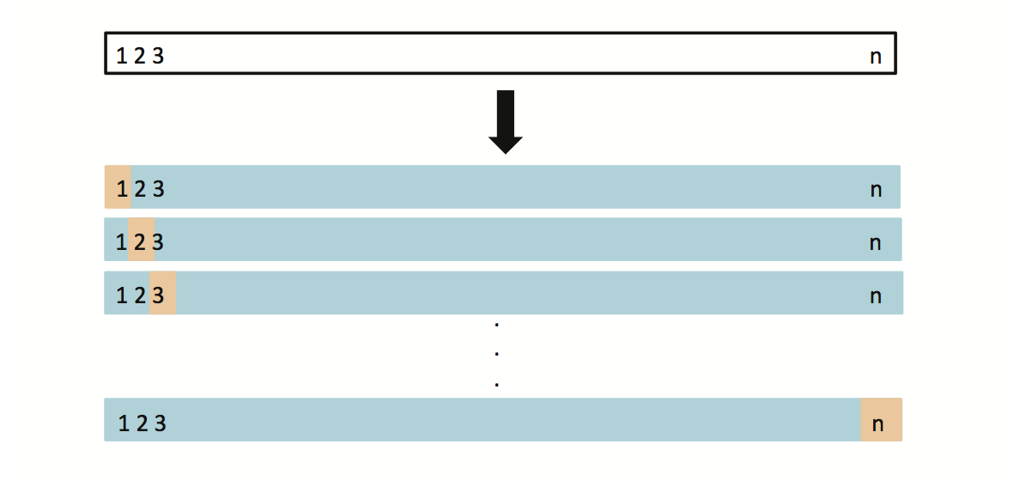
5.1.2 Leave-One-Out Cross Validation (LOOCV)
This method is similar to the Validation Set Approach, but it tries to address the latter’s disadvantages
For each suggested model, do:
Split the data set of size n into
Training data set (blue) size: n -1
Validation data set (beige) size: 1
Fit the model using the training data
Validate model using the validation data, and compute the corresponding MSE
Repeat this process n times
The MSE for the model is computed as follows:
Notes:
Leave-one-out cross-validation (LOOCV) is closely related to the validation set approach but it attempts to address that method’s drawbacks.
Like the validation set approach, LOOCV involves splitting the set of observations into two parts. However, instead of creating two subsets of comparable size, a single observation is used for the validation set, and the remaining observations make up the training set. The statistical learning method is fit on the n − 1 training observations, and a prediction is made for the excluded observation, using its predictor variable values. Since this observation was not used in the fitting process, the resulting error provides an approximately unbiased estimate for the test error. But even though MSE1 is unbiased for the test error, it is a poor estimate because it is highly variable, since it is based upon a single observation. A schematic of the LOOCV approach is illustrated in Figure
We can repeat the procedure by selecting the next observation for the validation data, training the statistical learning procedure on the n − 1 observations and computing the error with this new observations left out. Repeating this approach n times produces n squared errors. The LOOCV estimate for the test MSE is the average of these n test error estimates:

Slide 12
LOOCV vs. the Validation Set Approach
LOOCV has less bias
We repeatedly fit the statistical learning method using training data that contains n-1 obs., i.e. almost all the data set is used
LOOCV produces a less variable MSE
The validation approach produces different MSE when applied repeatedly due to randomness in the splitting process, while performing LOOCV multiple times will always yield the same results, because we split based on 1 obs. each time
LOOCV is computationally intensive (disadvantage)
We fit the each model n times!
Notes:
LOOCV has a couple of major advantages over the validation set approach. First, it has far less bias. In LOOCV, we repeatedly fit the statistical learning method using training sets that contain n − 1 observations, almost as many as are in the entire data set. This is in contrast to the validation set approach, in which the training set is typically around half the size of the original data set. Consequently, the LOOCV approach tends not to overestimate the test error rate as much as the validation set approach does. Second, in contrast to the validation approach which will yield different results when applied repeatedly due to randomness in the training/validation set splits, performing LOOCV multiple times will always yield the same results: there is no randomness in the training/validation set splits.
STOP

Slide 13
5.1.3 k-fold Cross Validation
LOOCV is computationally intensive, so we can run k-fold Cross Validation instead
With k-fold Cross Validation, we divide the data set into K different parts (e.g. K = 5, or K = 10, etc.)
We then remove the first part, fit the model on the remaining K-1 parts, and see how good the predictions are on the left out part (i.e. compute the MSE on the first part)
We then repeat this K different times taking out a different part each time
By averaging the K different MSE’s we get an estimated validation (test) error rate for new observations
Notes:
An alternative to LOOCV is k-fold CV. This approach involves randomly dividing the set of observations into k groups, or folds, of approximately equal size. The first fold is treated as a validation set, and the method is fit on the remaining k − 1 folds. The mean squared error, MSE1, is then computed on the observations in the held-out fold. This procedure is repeated k times; each time, a different group of observations is treated as a validation set. This process results in k estimates of the test error,. The k-fold CV estimate is computed by averaging these values,
CV formula

Slide 14
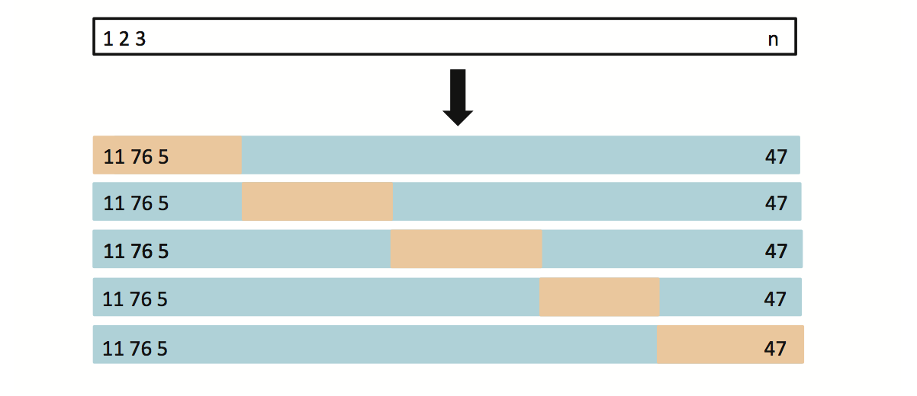
K-fold Cross Validation
Notes:
Figure 5.5 illustrates the k-fold CV approach.
It is not hard to see that LOOCV is a special case of k-fold CV in which k is set to equal n. In practice, one typically performs k-fold CV using k = 5 or k = 10. What is the advantage of using k = 5 or k = 10 rather than k = n? The most obvious advantage is computational. LOOCV requires fitting the statistical learning method n times. This has the potential to be computationally expensive (except for linear models fit by least squares). But cross-validation is a very general approach that can be applied to almost any statistical learning method. Some statistical learning methods have computationally intensive fitting procedures, and so performing LOOCV may pose computational problems, especially if n is extremely large. In contrast, performing 10-fold CV requires fitting the learning procedure only ten times, which may be much more feasible.

Slide 15
Auto Data: LOOCV vs. K-fold CV
LOOCV error curve
10-fold CV was run many times
slightly different CV error rates
LOOCV is a special case of k-fold, where k = n
They are both stable, but LOOCV is more computationally intensive!
Notes:
The right-hand panel of Figure 5.4 displays nine different 10-fold CV estimates for the Auto data set, each resulting from a different random split of the observations into ten folds. As we can see from the figure, there is some variability in the CV estimates as a result of the variability in how the observations are divided into ten folds.

Slide 16
Auto Data: Validation Set Approach vs. K-fold CV Approach
Validation Set Approach
10-fold Cross Validation Approach
Indeed, 10-fold CV is more stable!
Notes:
But this variability is typically much lower than the variability in the test error estimates that results from the validation set approach (right-hand panel of Figure 5.2).

Slide 17
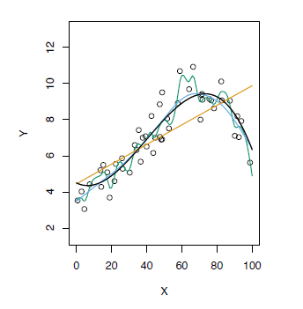
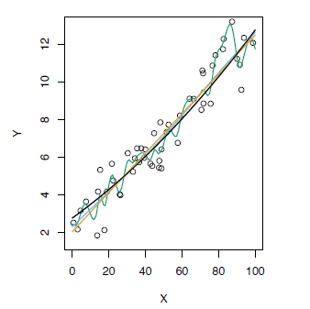
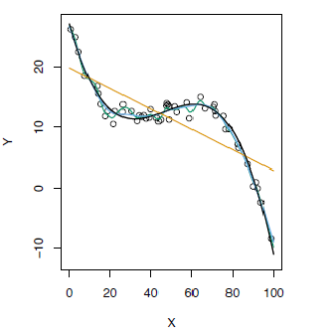
K-fold Cross Validation on Three Simulated Date
Blue: True Test MSE
Black: LOOCV MSE
Orange: 10-fold MSE
Refer to chapter 2 for the top graphs, Fig 2.9, 2.10, and 2.11
Notes:
When we examine real data, we do not know the true test MSE, and so it is difficult to determine the accuracy of the cross-validation estimate. However, if we examine simulated data, then we can compute the true test MSE, and can thereby evaluate the accuracy of our cross-validation results. In Figure , we plot the cross-validation estimates and true test error rates that result from applying smoothing splines to the simulated data sets from Chapter 2. The true test MSE is displayed in blue. The black dashed and orange solid lines respectively show the estimated LOOCV and 10-fold CV estimates. In all three plots, the two cross-validation estimates are very similar. In the right-hand panel of Figure, the true test MSE and the cross-validation curves are almost identical. In the center panel of Figure, the two sets of curves are similar at the lower degrees of flexibility, while the CV curves overestimate the test set MSE for higher degrees of flexibility. In the left-hand panel of Figure 5.6, the CV curves have the correct general shape, but they underestimate the true test MSE.
When we perform cross-validation, our goal might be to determine how well a given statistical learning procedure can be expected to perform on independent data; in this case, the actual estimate of the test MSE is of interest. But at other times we are interested only in the location of the minimum point in the estimated test MSE curve. This is because we might be performing cross-validation on a number of statistical learning methods, or on a single method using different levels of flexibility, in order to identify the method that results in the lowest test error. For this purpose, the location of the minimum point in the estimated test MSE curve is important, but the actual value of the estimated test MSE is not. We find in Figure that despite the fact that they sometimes underestimate the true test MSE, all of the CV curves come close to identifying the correct level of flexibility—that is, the flexibility level corresponding to the smallest test MSE.
STOP

Slide 18
5.1.4 Bias- Variance Trade-off for k-fold CV
Putting aside that LOOCV is more computationally intensive than k-fold CV… Which is better LOOCV or K-fold CV?
LOOCV is less bias than k-fold CV (when k < n)
But, LOOCV has higher variance than k-fold CV (when k < n)
Thus, there is a trade-off between what to use
Conclusion:
We tend to use k-fold CV with (K = 5 and K = 10)
These are the magical K’s ☺
It has been empirically shown that they yield test error rate estimates that suffer neither from excessively high bias, nor from very high variance
Notes:
We mentioned that k-fold CV with k<n has a computational advantage to LOOCV. But putting computational issues aside, a less obvious but potentially more important advantage of k-fold CV is that it often gives more accurate estimates of the test error rate than does LOOCV. This has to do with a bias-variance trade-off.
It was mentioned in Section 5.1.1 that the validation set approach can lead to overestimates of the test error rate, since in this approach the training set used to fit the statistical learning method contains only half the observations of the entire data set. Using this logic, it is not hard to see that LOOCV will give approximately unbiased estimates of the test error, since each training set contains n − 1 observations, which is almost as many as the number of observations in the full data set. And performing k-fold CV for, say, k = 5 or k = 10 will lead to an intermediate level of bias, since each training set contains (k − 1)n/k observations—fewer than in the LOOCV approach, but substantially more than in the validation set approach. Therefore, from the perspective of bias reduction, it is clear that LOOCV is to be preferred to k-fold CV.
However, we know that bias is not the only source for concern in an estimating procedure; we must also consider the procedure’s variance. It turns out that LOOCV has higher variance than does k-fold CV with k<n. Why is this the case? When we perform LOOCV, we are in effect averaging the outputs of n fitted models, each of which is trained on an almost identical set of observations; therefore, these outputs are highly (positively) correlated with each other. In contrast, when we perform k-fold CV with k<n, we are averaging the outputs of k fitted models that are somewhat less correlated with each other, since the overlap between the training sets in each model is smaller. Since the mean of many highly correlated quantities has higher variance than does the mean of many quantities that are not as highly correlated, the test error estimate resulting from LOOCV tends to have higher variance than does the test error estimate resulting from k-fold CV.
To summarize, there is a bias-variance trade-off associated with the choice of k in k-fold cross-validation. Typically, given these considerations, one performs k-fold cross-validation using k = 5 or k = 10, as these values have been shown empirically to yield test error rate estimates that suffer neither from excessively high bias nor from very high variance.
STOP

Slide 19
5.1.5 Cross Validation on Classification Problems
So far, we have been dealing with CV on regression problems
We can use cross validation in a classification situation in a similar manner
Divide data into K parts
Hold out one part, fit using the remaining data and compute the error rate on the hold out data
Repeat K times
CV error rate is the average over the K errors we have computed
Notes:
In this chapter so far, we have illustrated the use of cross-validation in the regression setting where the outcome Y is quantitative, and so have used MSE to quantify test error. But cross-validation can also be a very useful approach in the classification setting when Y is qualitative. In this setting, cross-validation works just as described earlier in this chapter, except that rather than using MSE to quantify test error, we instead use the number of misclassified observations. For instance, in the classification setting, the LOOCV error rate is just the measure of accuracy on our prediction; that is, did we guess the class of the test observation correctly? The k-fold CV error rate and validation set error rates are defined analogously.

Slide 20
CV to Choose Order of Polynomial
The data set used is simulated (refer to Fig 2.13)
The purple dashed line is the Bayes’ boundary
Bayes’ Error Rate: 0.133
Notes:
As an example, we fit various logistic regression models on the two dimensional classification data displayed here. The purple dashed line is the bayes error rate we discussed in chapter 2 and estimates the irreducible error for this data set.

Slide 21
CV to Choose Order of Polynomial
Linear Logistic regression (Degree 1) is not able to fit the Bayes’ decision boundary
Quadratic Logistic regression does better than linear
Error Rate: 0.201
Error Rate: 0.197
Notes:
In the left panel of this figure, the black solid line shows the estimated decision boundary resulting from fitting a standard logistic regression model to this data set. Since this is simulated data, we can compute the true test error rate, which takes a value of 0.201 and so is substantially larger than the Bayes error rate of 0.133. Clearly logistic regression does not have enough flexibility to model the Bayes decision boundary in this setting. We can easily extend logistic regression to obtain a non-linear decision boundary by using polynomial functions of the predictors, for example, we can fit a quadratic logistic regression model, given by The right hand panel of Figure displays the resulting decision boundary, which is now curved. However, the test error rate has improved only slightly, to 0.197.

Slide 22
CV to Choose Order of Polynomial
Using cubic and quartic predictors, the accuracy of the model improves
Error Rate: 0.160
Error Rate: 0.162
Notes:
A much larger improvement is apparent in the left panel of this Figure , in which we have fit a logistic regression model involving cubic polynomials of the predictors. Now the test error rate has decreased to 0.160. Going to a quartic polynomial (bottom-right) slightly increases the test error.

Slide 23
CV to Choose the Order
Logistic Regression
KNN
Brown: Test Error
Blue: Training Error
Black: 10-fold CV Error
Notes:
In practice, for real data, the Bayes decision boundary and the test error rates are unknown. So how might we decide between the four logistic regression models? We can use cross-validation in order to make this decision. The left-hand panel of Figure displays in black the 10-fold CV error rates that result from fitting ten logistic regression models to the data, using polynomial functions of the predictors up to tenth order. The true test errors are shown in brown, and the training errors are shown in blue. As we have seen previously, the training error tends to decrease as the flexibility of the fit increases. (The figure indicates that though the training error rate doesn’t quite decrease monotonically, it tends to decrease on the whole as the model complexity increases.) In contrast, the test error displays a characteristic U-shape. The 10-fold CV error rate provides a pretty good approximation to the test error rate. While it somewhat underestimates the error rate, it reaches a minimum when fourth-order polynomials are used, which is very close to the minimum of the test curve, which occurs when third-order polynomials are used. In fact, using fourth-order polynomials would likely lead to good test set performance, as the true test error rate is approximately the same for third, fourth, fifth, and sixth-order polynomials.
The right-hand panel of Figure displays the same three curves using the KNN approach for classification, as a function of the value of K (which in this context indicates the number of neighbors used in the KNN classifier, rather than the number of CV folds used). Again the training error rate declines as the method becomes more flexible, and so we see that the training error rate cannot be used to select the optimal value for K. Though the cross-validation error curve slightly underestimates the test error rate, it takes on a minimum very close to the best value for K.
STOP

Slide 24

The bootstrap
The bootstrap is a tremendously useful tool for constructing confidence intervals and calculating standard errors for difficult statistics
For example, how would one derive a confidence interval for the median?
The bootstrap procedure follows from the so called bootstrap principle
Notes:
The bootstrap is a widely applicable and extremely powerful statistical tool that can be used to quantify the uncertainty associated with a given estimator or statistical learning method. As a simple example, the bootstrap can be used to estimate the standard errors of the coefficients from a linear regression fit. In the specific case of linear regression, this is not particularly useful, since we saw in Chapter 3 that standard statistical software such as R outputs such standard errors automatically. However, the power of the bootstrap lies in the fact that it can be easily applied to a wide range of statistical learning methods, including some for which a measure of variability is otherwise difficult to obtain and is not automatically output by statistical software
Was invented in 1979 by a famous statistician named Bradley Efron who's in the Stanford Statistics Department, his contributions easily had a major impact in the field of statistics and virtually every area of statistical application.
And I would say the bootstrap is one of the, the most important procedures that's been discovered in the, in the history of statistics. And, and the reason being that it really liberated data analysts, from having to do a lot of mathematics in order to perform inferences.

Slide 25
The bootstrap principle
Suppose that I have a statistic that estimates some population parameter, but I don't know its sampling distribution
The bootstrap principle suggests using the distribution defined by the data to approximate its sampling distribution
Notes:
So as, just as a simple example, if you wanted to do a confidence interval for the median, there are some kind of complicated asymptotics that you can appeal to, but it involves a lot of mathematics.
On the other hand, you can just perform a bootstrap and it gives you a confidence interval for the median, without having to do all of that work. So it, you know maybe, maybe dangerously so but none the less it liberated people from having to do a lot of complex mathematics, to understand some distributional properties of statistics that they calculated.
So the bootstrap principle, is if you have a statistic that estimates some population parameter that you're interested in, but you don't know that statistic's sampling distribution.
Then the bootstrap principle, is simply to use the distribution defined by the observed data,
to investigate that sampling is for me to estimate of that sampling distribution.

Slide 26
The bootstrap in practice
In practice, the bootstrap principle is always carried out using simulation
We will cover only a few aspects of bootstrap resampling
The general procedure follows by first simulating complete data sets from the observed data with replacement
This is approximately drawing from the sampling distribution of that statistic, at least as far as the data is able to approximate the true population distribution
Calculate the statistic for each simulated data set
Use the simulated statistics to either define a confidence interval or take the standard deviation to calculate a standard error
Notes:
The bootstrap principle actually doesn't require simulation, in the same way that if we want to know what is the distribution of the average of 50 die rolls. Well, we could maybe mathematically figure that out. Good luck. But it's easier to do that with simulation. So we never kind of figure out what's the limit of what you get when you roll the die infinitely many times, because, you know, we can, we can approximate that so well with Monte Carlo.
We're also only going to cover a couple of aspects of what you can do with your bootstrapper samples. It's a rich subject, and we're mostly going to cover creating a confidence interval and estimating standard errors. So we'll go over those two things.
But let's go over the general procedure again. What you do is you take your, your observe data. And you simulate complete data sets by drawing from the observed data with replacement.
And this is approximately drawing, in in, for each of the simulated data sets you calculate the statistic of interest, and this is approximately drawing from the sampling distribution of that statistic. At least as far as the data approximates the real population distribution.
So just as a reminder, we're going to calculate the statistic for each simulated data set, and then we're going to use these simulated statistics to either define a confidence interval or to take the standard deviation of this distribution in order to calculate a standard error.

Slide 27
Nonparametric bootstrap algorithm example
Bootstrap procedure for calculating confidence interval for the median from a data set of n observations
Sample n observations with replacement from the observed data resulting in one simulated complete data set
Take the median of the simulated data set
Repeat these two steps B times, resulting in B simulated medians
These medians are approximately drawn from the sampling distribution of the median of n observations; therefore we can
Draw a histogram of them
Calculate their standard deviation to estimate the standard error of the median
Take the 2.5 and 97.5 percentiles as a confidence interval for the median
Notes:
So, let's go through the bootstrap algorithm in a little bit of detail, for calculating a confidence interval or bootstrap standard air for the median from a set of N observations.
So, the data that we have is a vector of length N. Then, what we're going to do is re-sample N observations with replacement from the observed data to basically get a re-sampled complete data set. Remember, when you sample from the observed data, you're going to sample with replacement. If you didn't do it with replacement, then you would basically after having simulated sampled N of them, you would just have a copy of the data set again just with the order permuted. Instead it's important to sample with replacement, which means that you likely get some observations repeated on multiple times, which is fine. This is part of bootstrap resampling, when you get a resampled data set,
in our example, we're going to take the median, or if you're using a different statistic, you'll simply take that statistic, of the simulated data set.
Then you're going to repeat this step, over and over. I say B times. Here me, where B is the number of bootstrap re-samples. You want B to be large, so that your Monte Carlo error is small. And what I mean by that is remember, if we could, we would just figure out the distribution without any resampling, we’s know exactly what the distribution of the median is from a distribution that places probability 1 over N on each observed data point.
Instead we're going to do it via Monte Carlo this process of re-sampling, so you don't want the Monte Carlo error or basically how long you've run your computer, to be driving your results. The easiest way to fix this is to simply make B be fairly large, 10,000 or more simulations. The medians that you get from this process are approximately drawn from the sampling distribution of the median of N observations. We're really sort of approximating the population distribution, but that's okay. There's a lot of theory that shows that the bootstrap actually works.
When we do this, what we can do with our bootstrap resamples is the first thing you always want to draw a density estimate or a histogram of them. But you also could calculate their standard deviation which will give you a standard error of the median an estimated standard error of the median. You could take quantiles of your bootstrap re-sampled medians and, say, for example, the 2.5th and 97.5th quantile, and those form are so-called bootstrap confidence interval for the median. So notice what we've done in this process is we've figured out a very easy way to develop a confidence interval for the median, without having to do anything like fancy anstotics.

Slide 28
Example code
x<-mpg$mtcars; B <- 1000; n <- length(x)
resamples <- matrix(sample(x, n * B, replace = TRUE),
B, n)
medians <- apply(resamples, 1, median)
sd(medians)
quantile(medians, c(.025, .975))
Notes:
Let's go through some quick example code. Suppose we assigned this vector X to be some column of data like the mpg variable of mtcars. I'm going to define B to be 10,000, that's going to be my number of bootstrap resamples. And I've already previously defined N as the length of X, the number of observations that I have.
So, if I want to draw N complete data sets with replacement, a B complete data sets with replacement from X, then I need N times B draws. The R command sample does this where it’s X as the vector that I'm sampling from, N times B. The number of times that I want to draw from it and replace equals true. In this case if I didn't have replace equals true, it would give me an error because you can't draw N times B elements from X which only has N elements without replacement. This now gives me a vector of N times B samples from X.
And I simply arrange them into a matrix, with B rows and N columns. So every row now, is a bootstrap resample. And it has N observations.
So, I'm going to go along the rows in the next line and take the median for each row.
When I take my standard deviation of my medians, I get 0.08473. This is an estimated standard error of the median.
If we want a confidence interval for the median. I'm going to take my vector of re-sampled medians. And I am going to simply take the quantiles. And I want a 95% intervals, so I am going to take the 2.5 and the 97.5 quantiles. It gives a fairly tight confidence interval in this case because there's lots and lots of observed data.

Slide 29
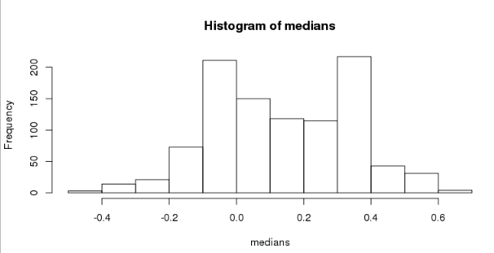
Histogram of bootstrap resamples
hist(medians)
Notes:
Here's my histogram of bootstrap resamples, and this is just always a good thing to do. So this plot is an estimate, of the sampling distribution of the median. If we had the true population distribution, and we were to sample over and over again. This would be a very good estimate up to Monte Carlo error of the sampling distribution of the median.
Instead, we don't have the exact population distribution we've replaced it with the bootstrap principle of resampling from the observed data. And now instead we just get this approximate, distribution which is out best guess of the sample distribution of the median.

Slide 30
Notes on the bootstrap
The bootstrap is non-parametric
Better percentile bootstrap confidence intervals correct for bias
There are lots of variations on bootstrap procedures; the book "An Introduction to the Bootstrap"" by Efron and Tibshirani is a great place to start for both bootstrap and jackknife information
Notes:
So a couple of final notes on the bootstrap. The way in which we presented the bootstrap here is the so called non-parametric bootstrap.
The confidence interval that I showed you just taking the 2.5th and 97.5th percentiles is actually a somewhat poorly performing confidence interval, and you can improve on it very easily. The one I would recommend, is called the bias-corrected and accelerated interval, BCa interval, and it's very easy to implement in the bootstrap package in R. You simply take your bootstrap resamples and pass it through this function, and it just gives you the BCa interval. It's basically a quick, little fix of what quantiles you take to correct for a bias.
What I've done here, is I've just given you a very basic introduction to the bootstrap. It is a, an incredibly useful procedure and it has lots of variations and extremely wide applicability and a lot of intricacies when you try to apply it in settings like when you have time series. Or when your have a regression model or when you have longitudinal or multi level data.
STOP

Slide 31
Bootstrap aggregating (bagging)
Basic Idea:
Resample cases and recalculate predictions
Average or majority vote
Notes:
Similar bias
Reduced variance
More useful for non-linear functions
Notes:
This lecture is about bagging, which is short for bootstrap aggregating. The basic idea is that when you fit complicated models, sometimes if you average those models together, you get a smoother model fit, that gives you a better balance between potential bias in your fit and variance in your fit.
So bootstrap aggregating has a very simple idea. The basic idea is take your data and take resamples of the data set. So, this is the similar to the idea of bootstrapping, which you would have learned about in the inference class that is part of the data science specialization. After you resample the cases with replacement, then you recalculate your prediction function on that resampled data. And then you either average the predictions from all these repeated predictors that you built or you majority vote or something like that when you're doing classification.
The thing is that you get a similar bias that you would get from fitting any one of those models individually, but a reduced variability because you've averaged a bunch of different predictors together. This is most useful for non-linear functions. So, we'll show an example with smoothing, but it's also very useful for things like predicting with trees.

Slide 32
Ozone data
library(tidyverse)
link="https://web.stanford.edu/~hastie/ElemStatLearn/datasets/ozone.data"
ozone<-read_delim(link,delim="\t")
ozone<-ozone[order(ozone$ozone),]
## # A tibble: 111 x 4
## ozone radiation temperature wind
## <dbl> <dbl> <dbl> <dbl>
## 1 1 8 59 9.7
## 2 4 25 61 9.7
## 3 6 78 57 18.4
## 4 7 48 80 14.3
## # ... with 107 more rows
https://en.wikipedia.org/wiki/Bootstrap_aggregating
Notes:
So I'm going to use the ozone data from the ElemStatLearn package. For the purposes of showing you how this works, I'm going to order the data set by the outcome, the ozone variable here.
The data set and I can see it has four variables, ozone, radiation, temperature, and wind. I'm going to try to predict temperature as a function of ozone.

Slide 33
Bagged loess
ll<-matrix(NA,nrow=10,ncol=155)
for(i in 1:10){
ss<-sample(1:dim(ozone)[1],replace=T)
ozone0<-ozone[ss,]; ozone0<-ozone0[order(ozone0$ozone),]
loess0<-loess(temperature~ozone,data=ozone0,span=0.2)
ll[i,]<-predict(loess0,newdata=data.frame(ozone=1:155))
}
Notes:
To show how this works, I'm going to create a matrix here and it's going to have 10 rows and a 155 columns. Then what I'm going to do is, I'm going to resample the data set ten different times, so then a loop over ten different samples of the data set. Each time I'm going to sample width replacement from the entire data set.
Then I'm going to create a new data set, ozone0, which is the resample data set for that particular element of the loop. And that's just the subset of the data set corresponding to our random sample. Then I'm going to reorder the data set every time by the ozone variable, and you'll see why in just a minute. Then I fit a loess curve each time which is a smooth curve that you can fit through the data. It's very similar to the spline model fits that we saw the first chapter. And so the basic idea is we're fitting a smooth curve relating temperature, to the ozone variables. So temperature is the outcome, and ozone is the predictor, and each time I use the resample data set as the data set I'm building that predictor on. And I use a common span for each time, the span being a measure of how smooth that fit will be.

Slide 34
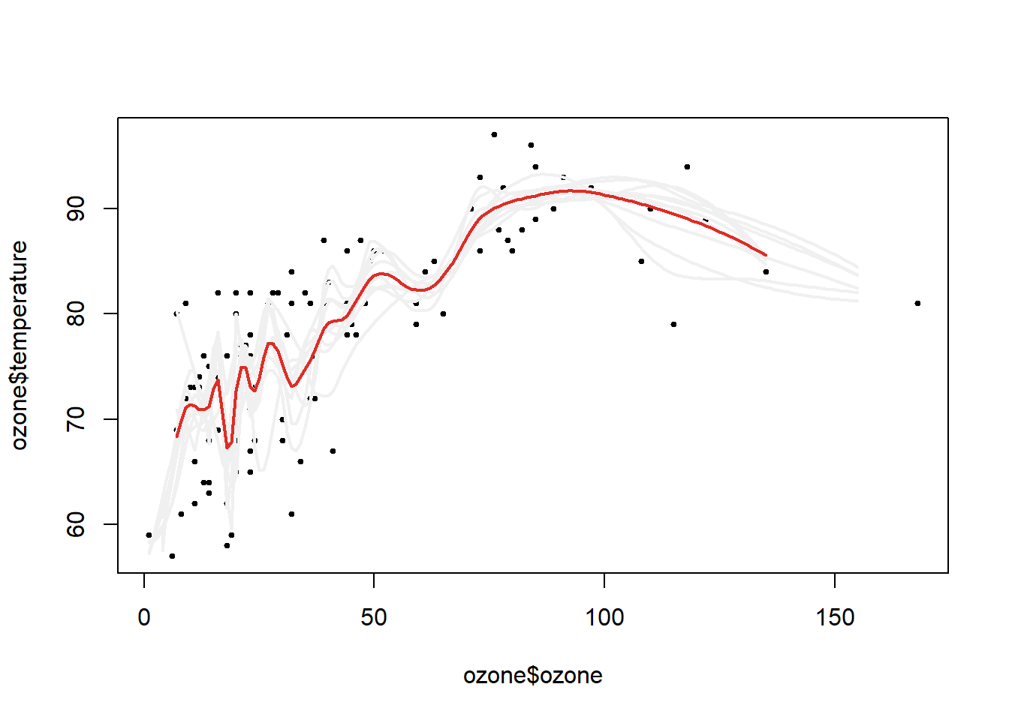
Bagged loess
plot(ozone$ozone,ozone$temperature,pch=19,cex=0.5)
for(i in 1:10){lines(1:155,ll[i,],col="#f0f0f0",lwd=2)}
lines(1:155,apply(ll,2,mean),col="#de2d26",lwd=2)
Notes:
I then predict for every single loess curve the outcome for a new data set for the exact same values. I always predict for ozone values 1 to 155. So the ith row of this ll object is now the prediction from the loess curve, from the ith resample of the date ozone. So what I've done here? I've resampled my data set ten different times, fit a smooth curve through it those ten different times, and then what I'm going to do is I'm going to average those values.
So, here's what it looks like in this plot. So, here I've plotted ozone on the x axis, these are the observed ozone values versus temperature on the y axis, those are the observed temperature values, and each black dot represents an observation. Each gray line here represents the fit with one resampled data set. So you can see the gray lines that have a lot of curviness to them. They capture a lot of the variability in the data set. But they also maybe over-capture some of the variability. They're little bit too curvy. Once I've averaged those lines together I get something that's a little bit smoother and is closer to the middle of the data set. That's the red line. So the red line is the bagged loess curve. It's basically the average of multiple fitted loess curves, the same data set where I've resampled it every time.

